Slide 1

Lecture 7
Database Development Lifecycle [DDLC]
Dr. Sanjeev Kumar
Asst. Professor

Slide 2
Database Development Lifecycle [DDLC]
A DDLC is a subset of SDLC [Software development life cycle] and is used to design, plan, develop, deploy, maintain a database.
A DDLC pens down the life of a database that could be from a simple drawing on your board to actual deployment and maintenance at client live-side.

Slide 3
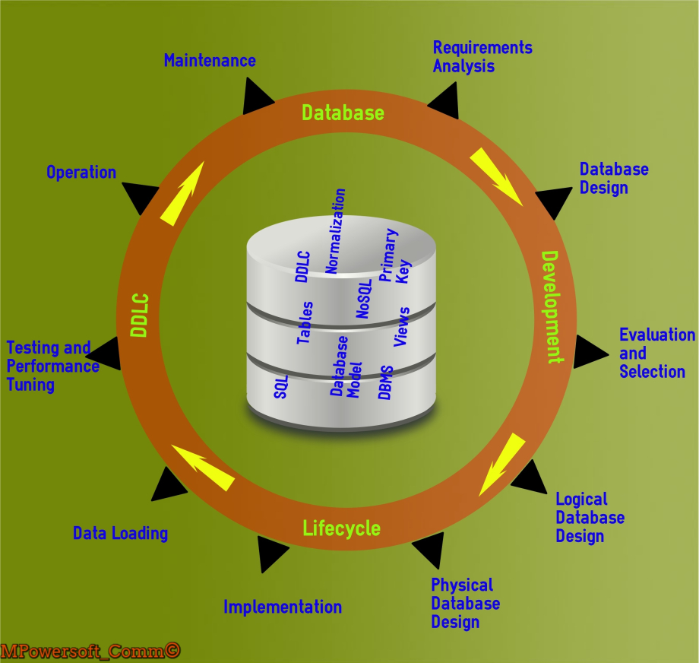

Slide 4
Requirements Analysis
The first baby step of database development lifecycle is to gather answers for “what and why” a database is needed and designed for.
Database Design
The database designers will work on the database model that is the best fit as per the requirement, budget, performance and easy to use.

Slide 5
Evaluation and Selection
The tricky part is the evaluation of tools and picking the one that suits your project, budget, performance needs and ease of use
Logical Database Design
The logical database design is software dependent and requires mapping up of the conceptual design onto the underlying data model of the DBMS tool selected

Slide 6
Physical Database Design
This stage required a DBA to select the data access and data storage characteristics as per the conceptual design but supported by the DBMS tool picked.
Implementation
The phase dictates about the creation of special storages for end user tables like constructs for table spaces, data files, tables, etc.

Slide 7
Data Loading
Data loading is another vital phase of database development lifecycle [DDLC] as data needs to be formatted as per the database needs, and then migrated or loaded using tools into the database.
Testing and Performance Tuning
Testing of the database is of utmost importance to know if the actual and expected results are matching and to get them fixed.

Slide 8
Operation
The phase is where most of the team awaits, as the code is released into production and actual users would test and use it.

Slide 9
Maintenance
The phase is not just about maintaining the live site database but as and when the new requirements are being added, it is essential to ensure that database functions smoothly. Few of the tasks undertaken in this phase are –
Performance tuning
Database backup and recovery
Database designs modifications
Database audits (access audits, usage audits, security audits, etc.)
Database access management
Hardware maintenance
Usage monitoring
DBMS Software up gradation

